Slide 1
Conference Schedular
Client
McAtee,Brooke N
Mentor
Dr. Kotteti,Chandra Mouli Madhav
Team Alpha
Rohith Chittipolu(Captain)
Aishwarya Mallela
Satwika Guntipally
Aakanksha reddy Sunkireddy
Shaik,Abdul Khayyam Sahib

Slide 2


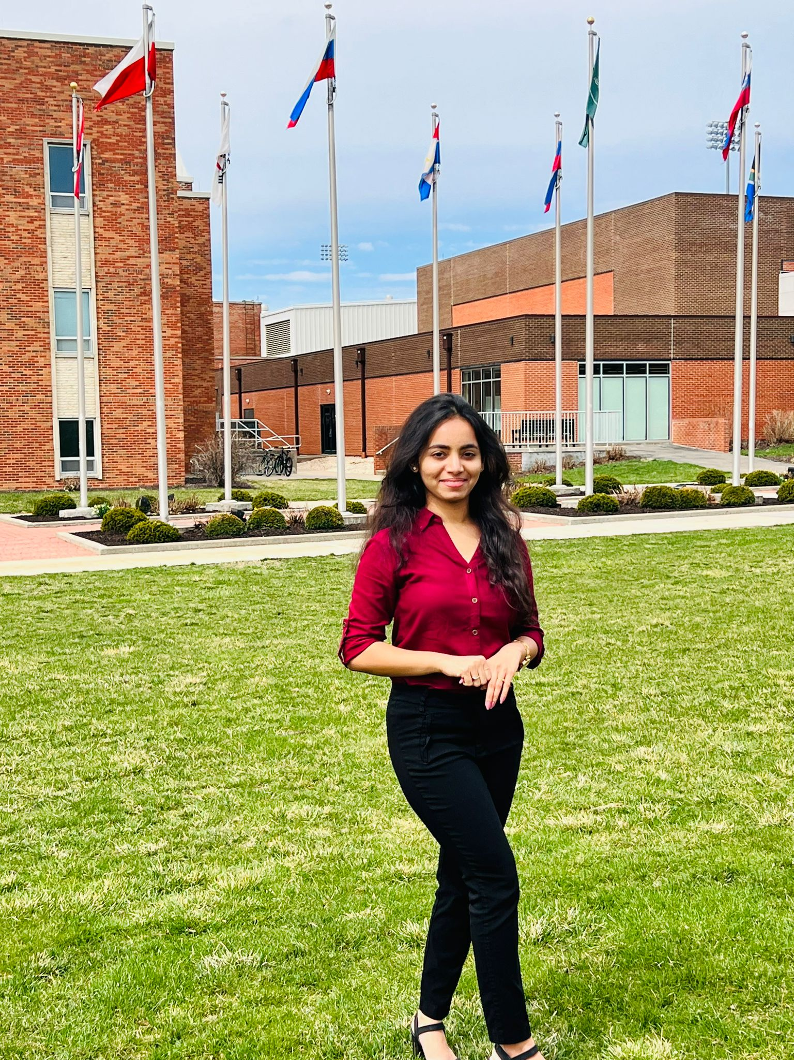
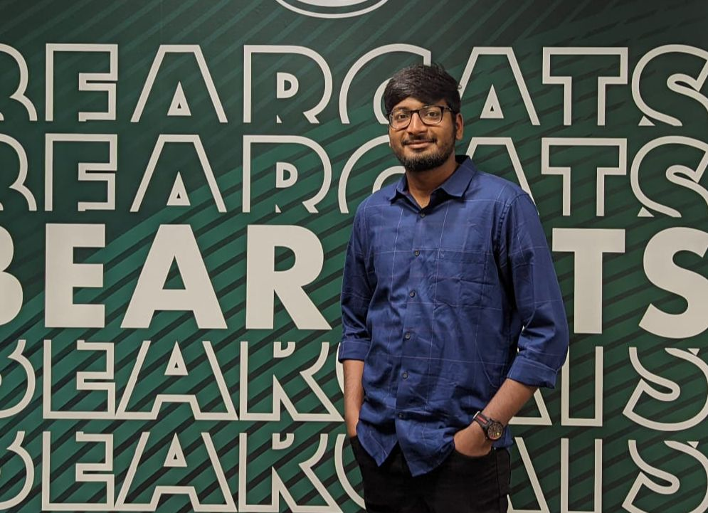
TEAM MEMBERS:
Aishwarya Mallela
Rohith Chittipolu (Captain)
Satwika Guntipally
Abdul Khayyum Shaik

Slide 3
Outline:
Introduction
Application Overview
UI Design
Navigation bars
Database
Pilot project about Api's
Summary
Lessons Learnt

Slide 4
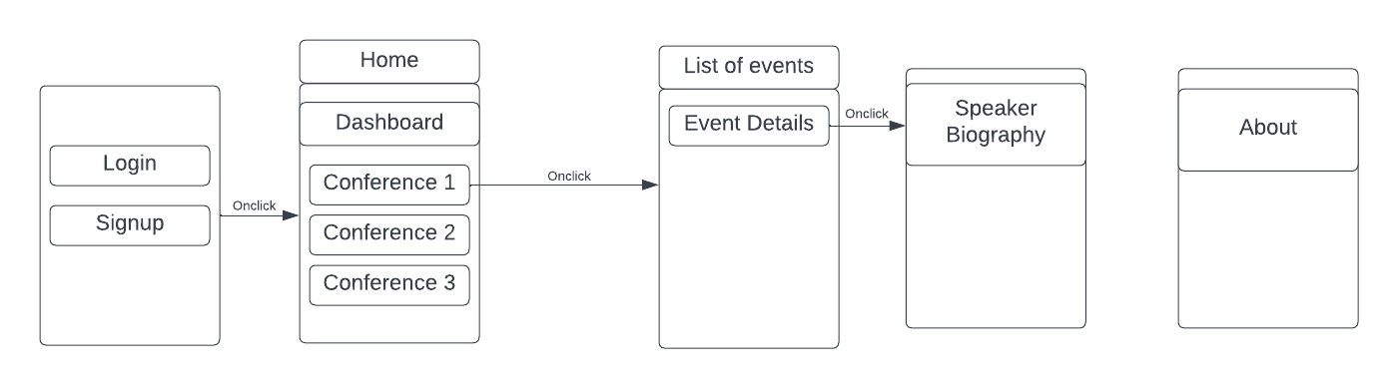
Application Overview:

Slide 5
Key UI elements
Text Fields
Image view
Label
Switches
List View
Buttons
Navigation Bar
Tab Bar

Slide 6
Navigation Bar
Navigation Controller
Usage of Navigation Controller
When to use?

Slide 7
Home Page
Homepage

Slide 8
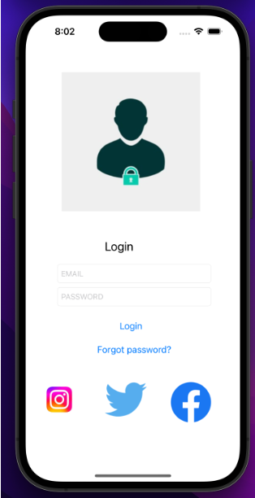
Login page

Slide 9
Data Storage
UserDefaults
Keychain
File System
SQLite
Core Data

Slide 10
SQLite
An SQL database requires us to organize our models in tables
SQLite frameworks let us pass a path to file on the file system.
They use this file to create the SQLite database, then open a connection toward it for the app to interact with.
SQLite is a database. The best use case for it is when we have a ton of well-structured data.

Slide 11
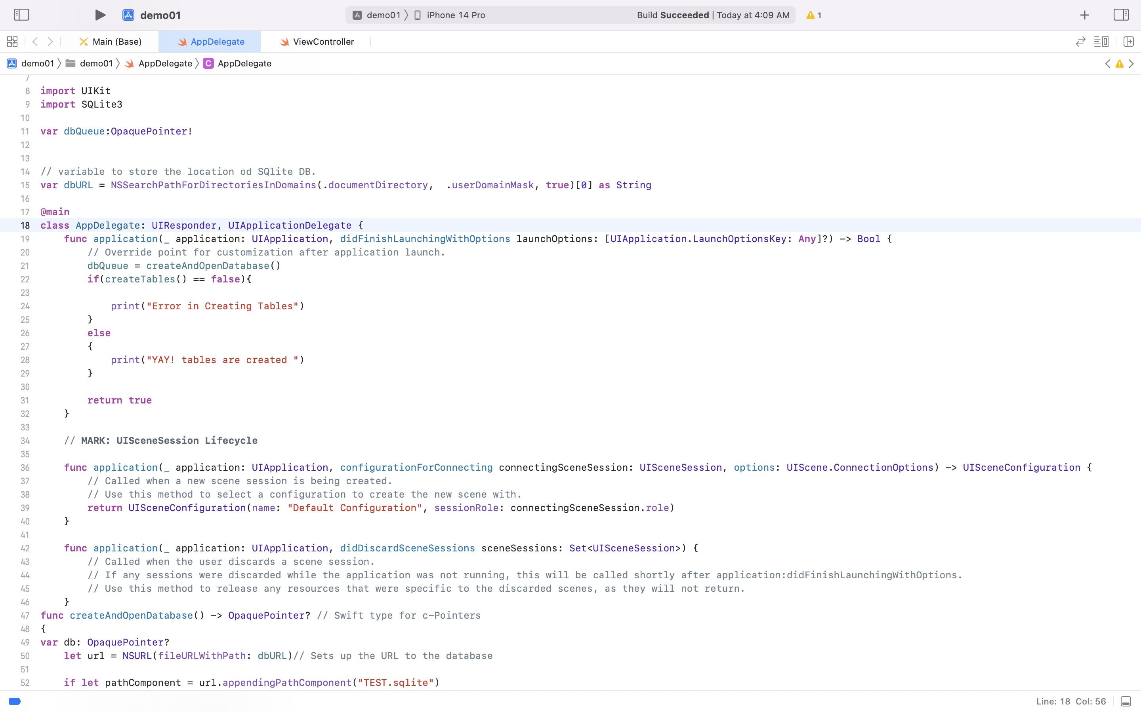
AppDelegate

Slide 12
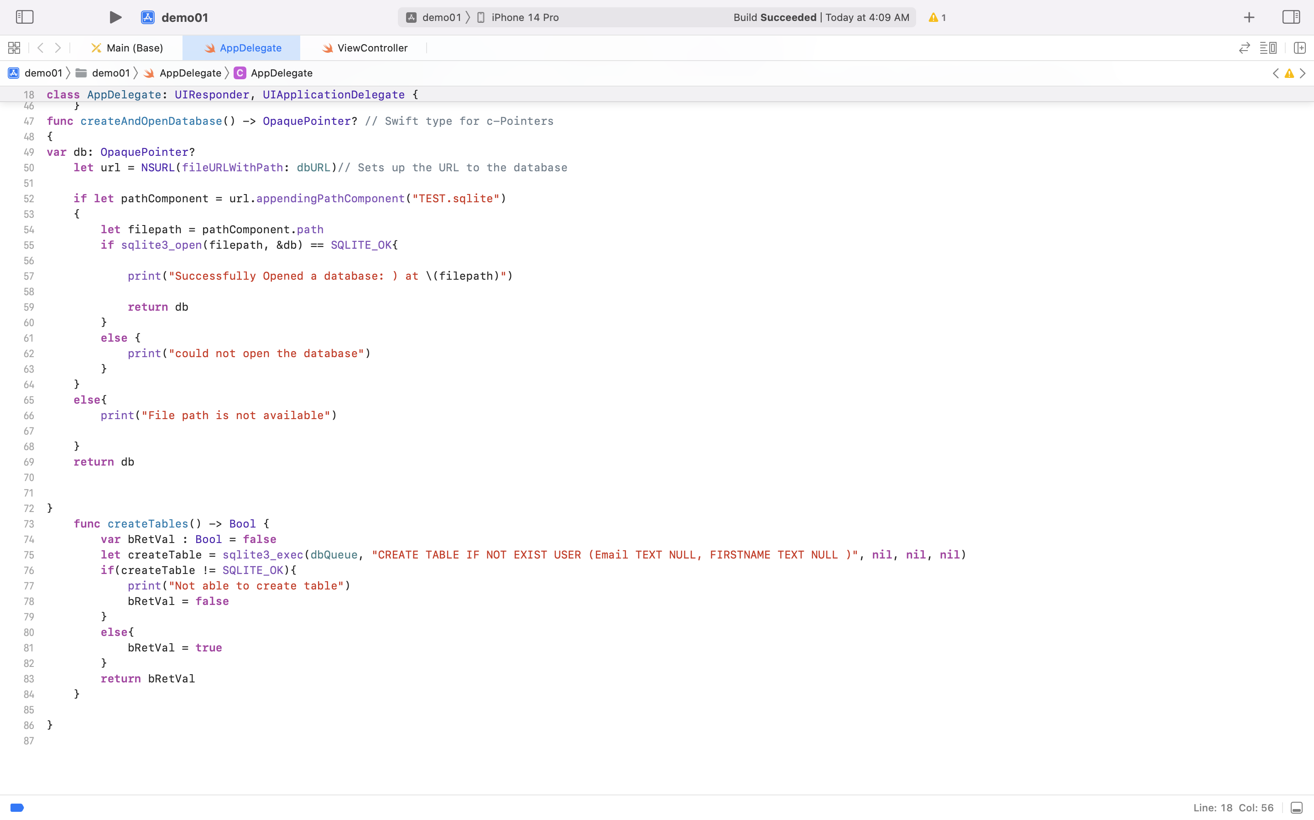
AppDelegate

Slide 13
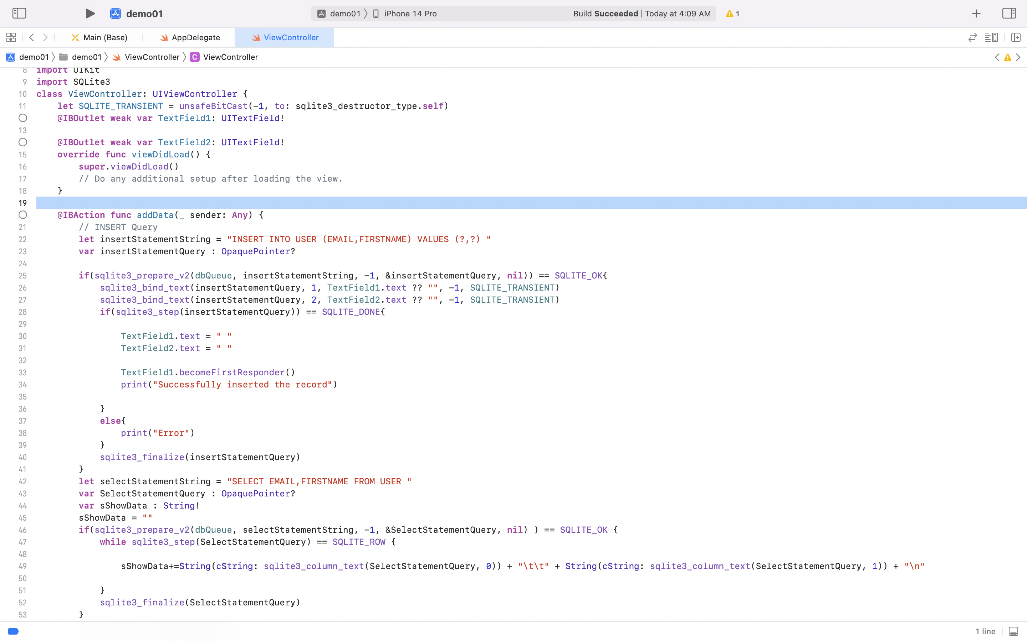
ViewController

Slide 14
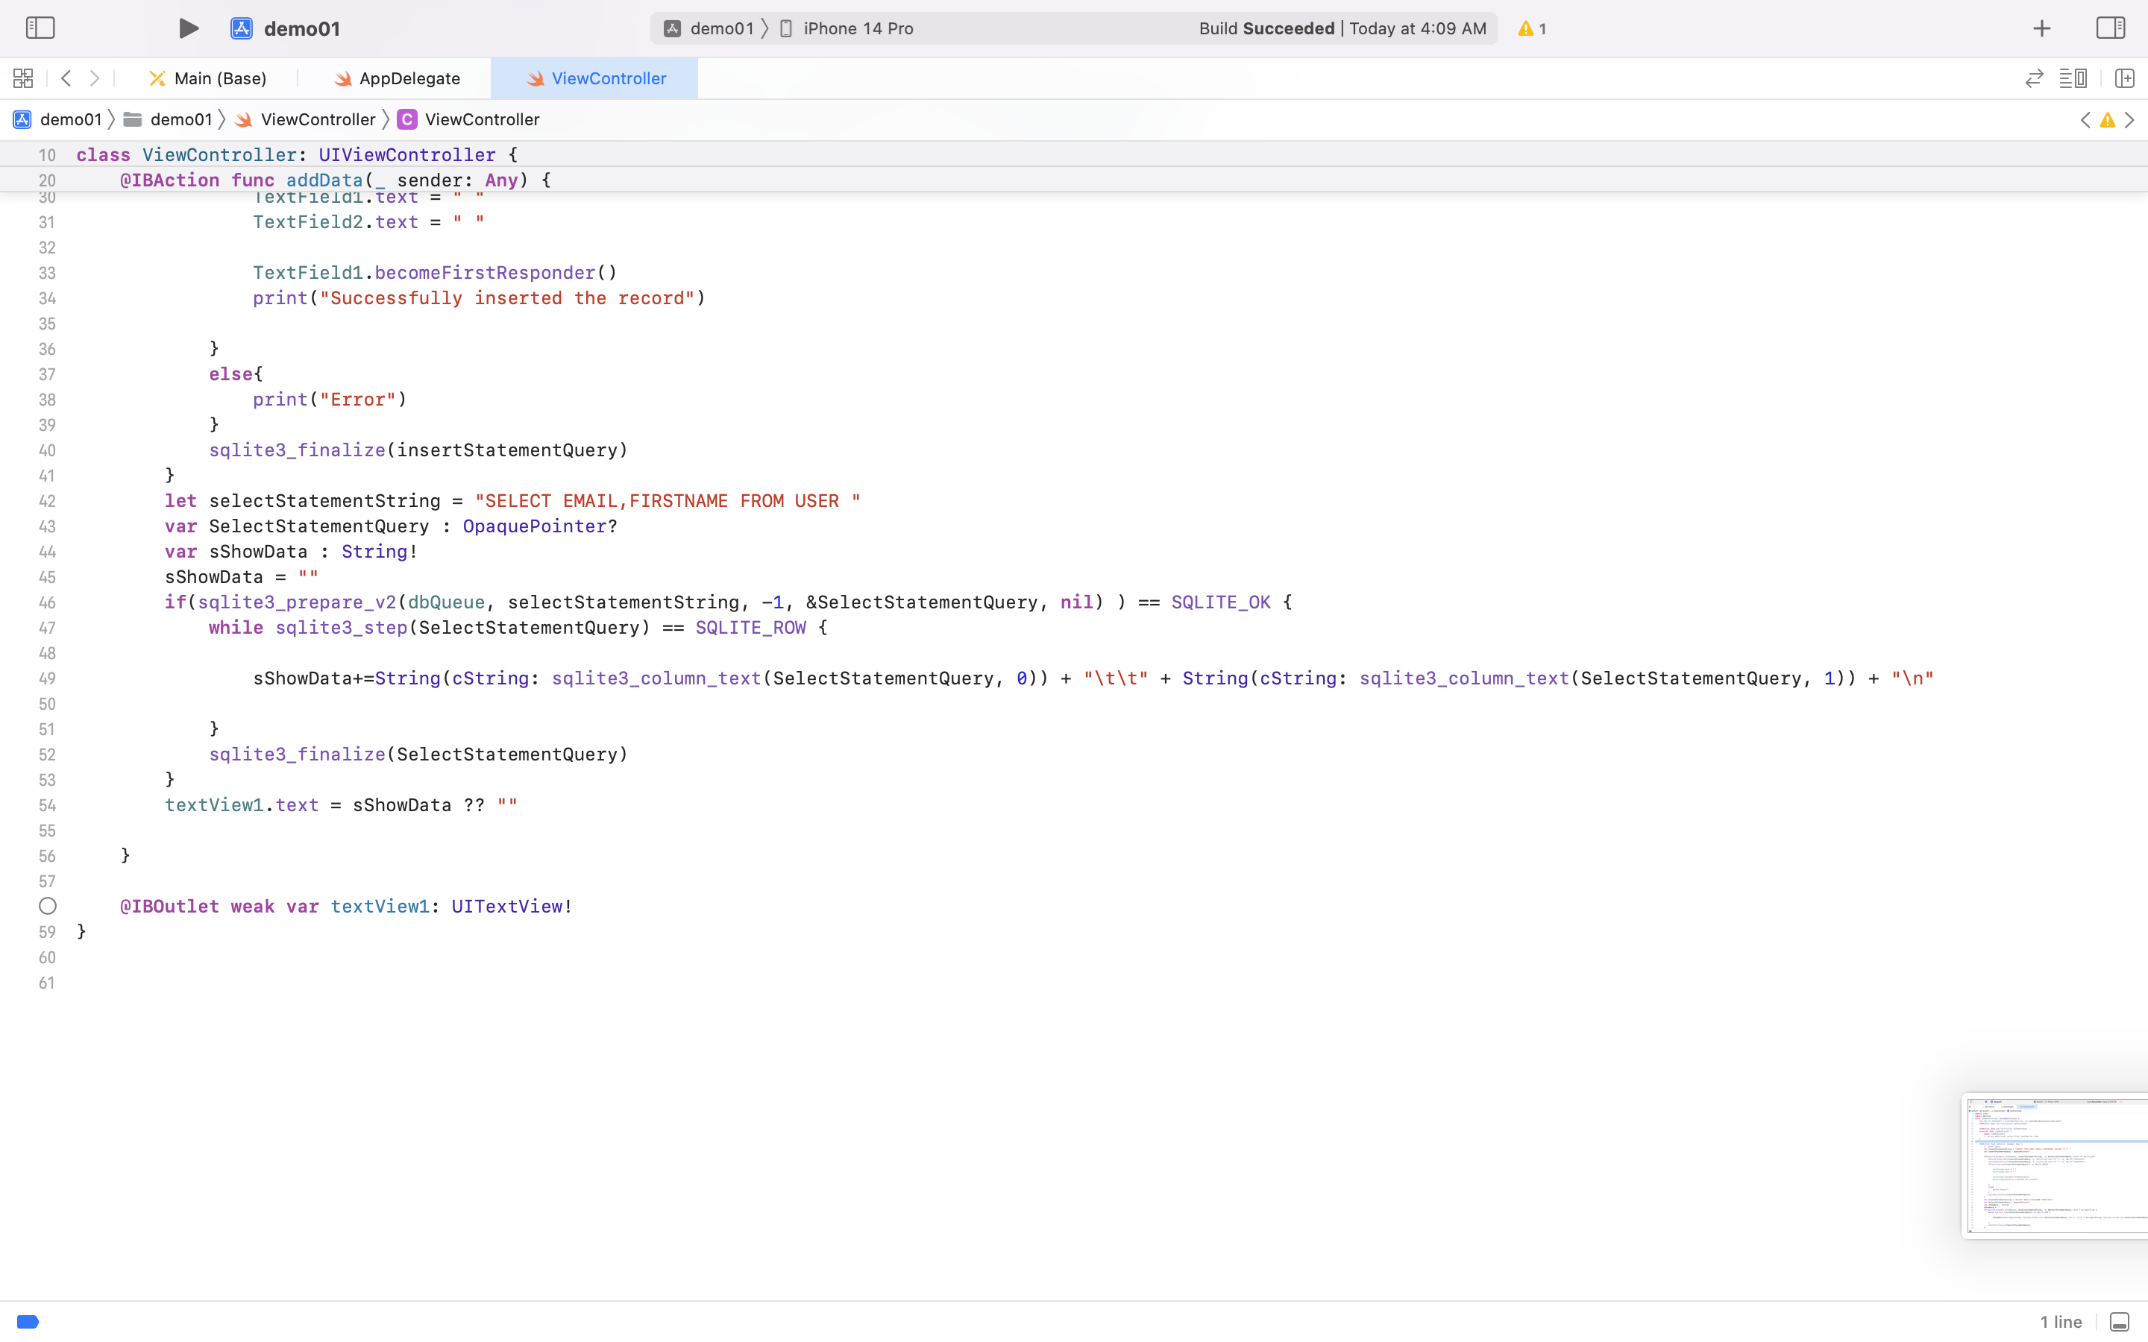
ViewController

Slide 15
Types of View Controllers For An iOS Application
Nav-Bar Controllers
Tab-bar Controllers
View Controllers

Slide 16
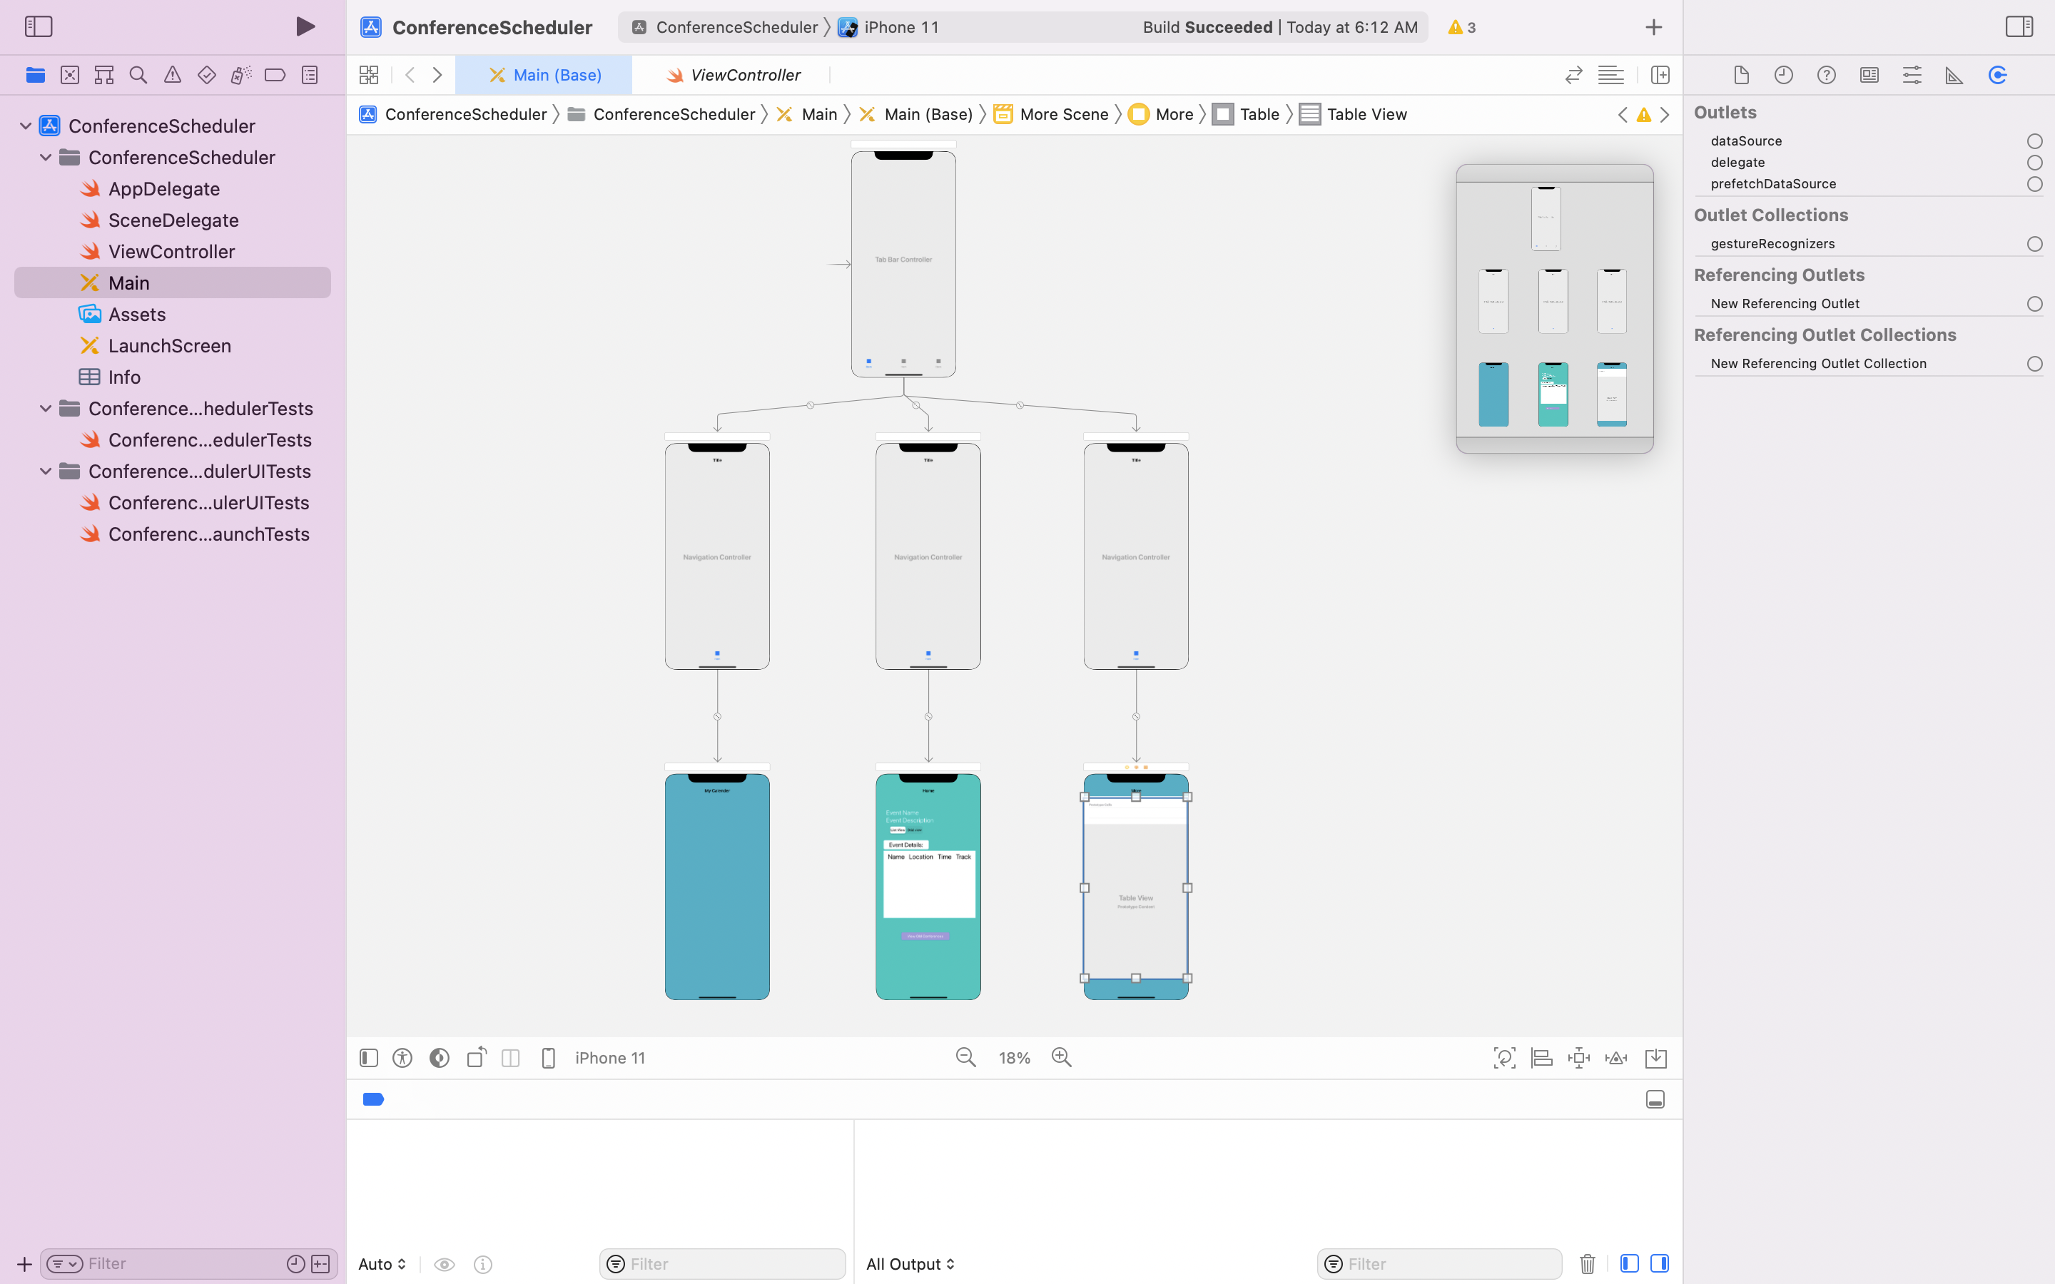
Tab-Bar Controller

Slide 17
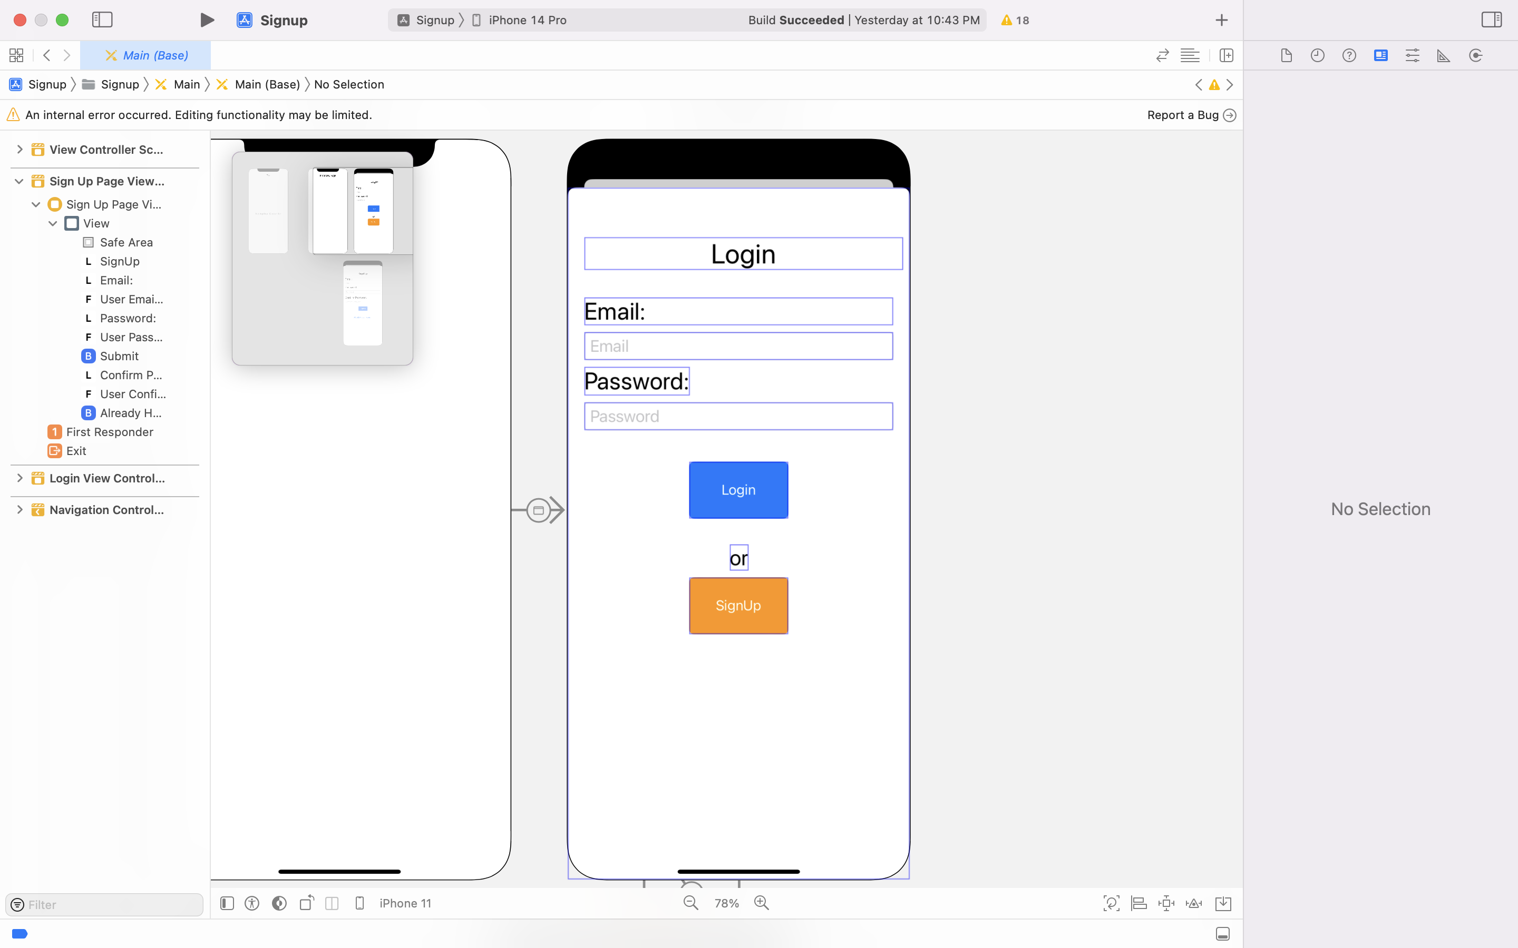
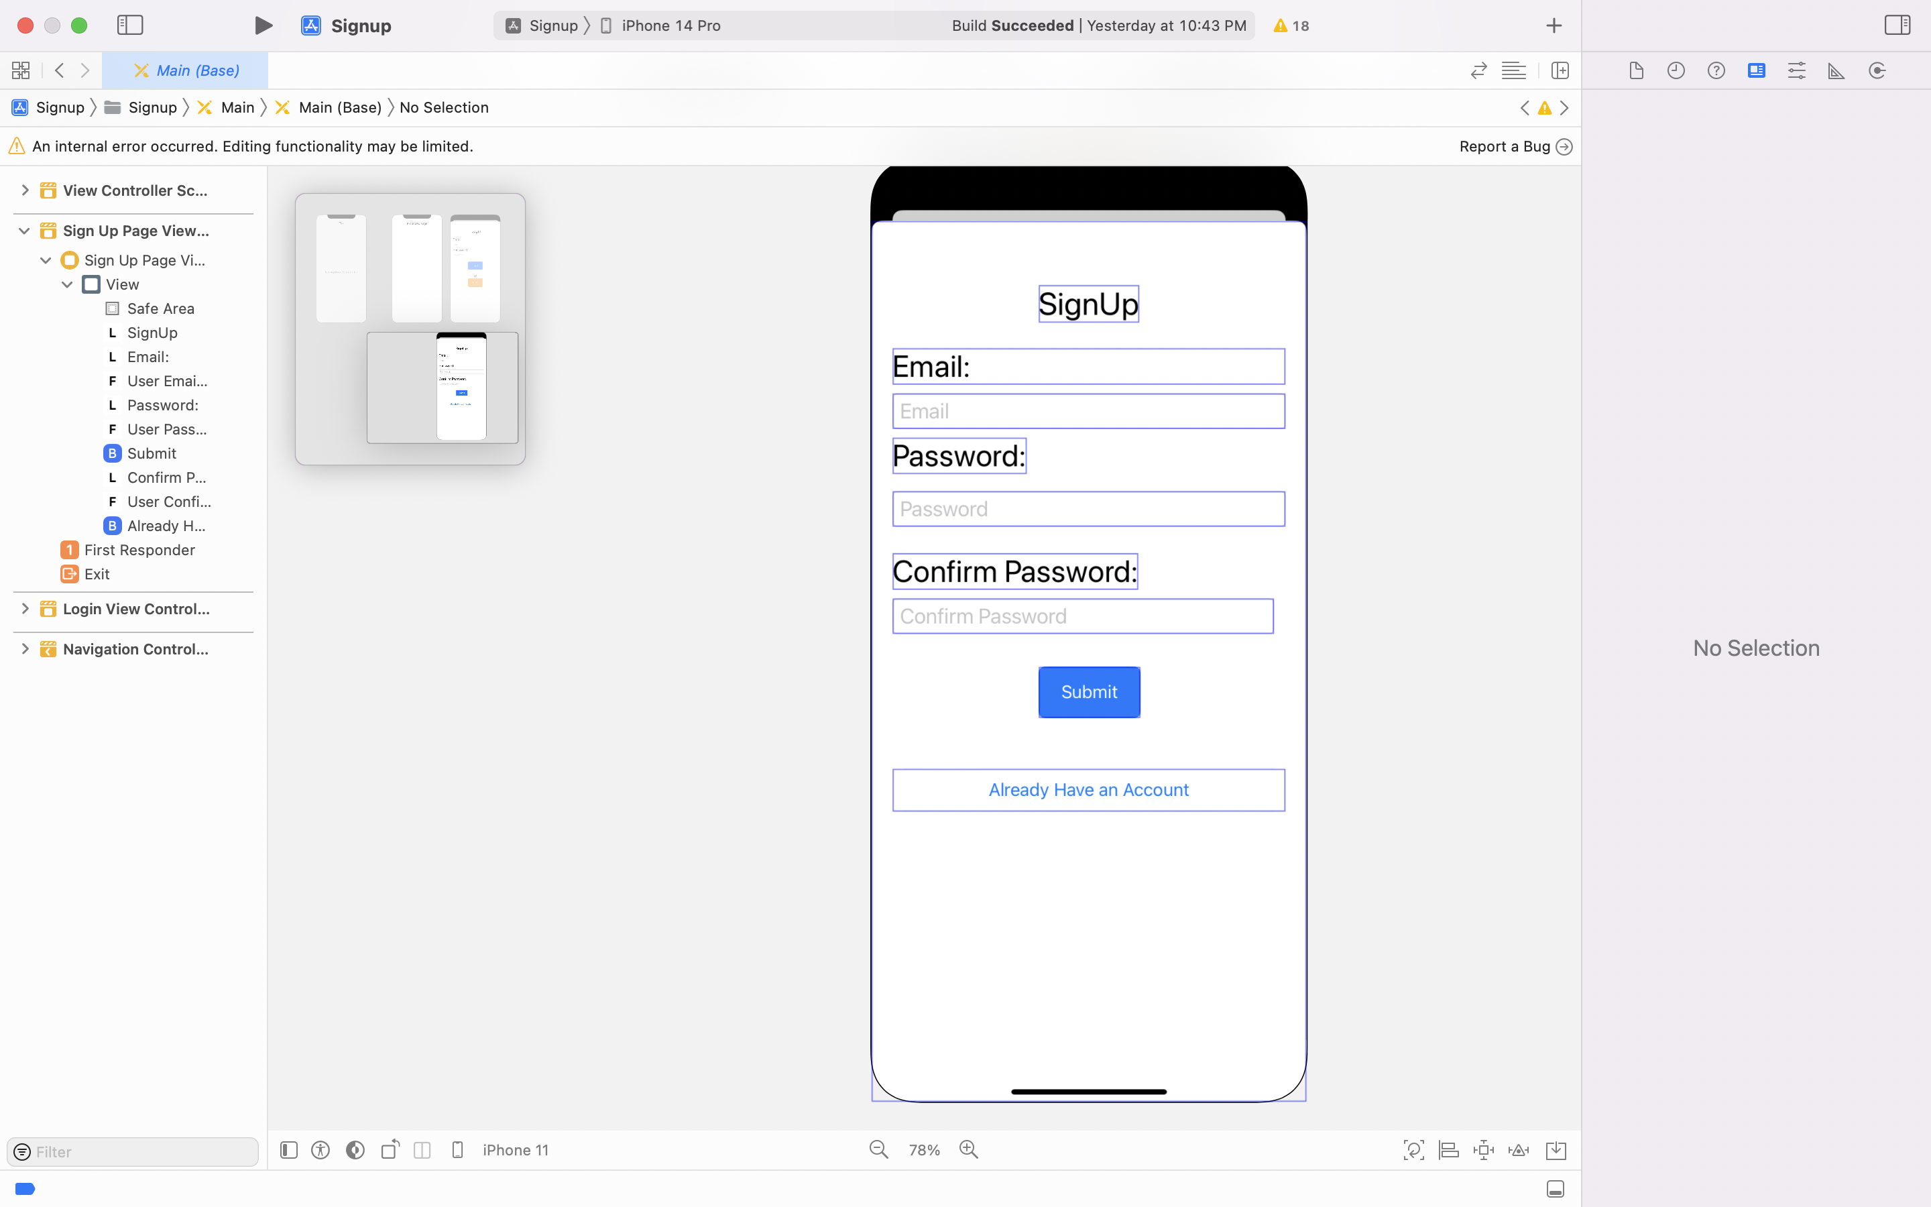
Login and SignUp Segues

Slide 18
Summary and Lessons Learnt
Application Overview
UI Design
Navigation bars
Database

Slide 19


Slide 20
Conference Schedular
Client
McAtee,Brooke N
Mentor
Dr. Kotteti,Chandra Mouli Madhav
Team Alpha
Rohith Chittipolu(Captain)
Aishwarya Mallela
Satwika Guntipally
Aakanksha reddy Sunkireddy
Shaik,Abdul Khayyam Sahib

Slide 21
TEAM MEMBERS:
Aishwarya Mallela
Rohith Chittipolu (Captain)
Satwika Guntipally
Abdul Khayyum Shaik

